Slide 1

Hate Comments Detection on Vietnamese Social Media
Class: 152449
Instructors: Assoc. Vũ Hải
Nguyễn Huy Hoàng
Đinh Quang Hiển
Nguyễn Hoàng Hiệp
Hồ Sỹ Hiếu
- 20224313
20224281
20224282
20224271

Slide 2
Introduction
01

Slide 3
01. Introduction
With the rapid growth of the internet, the number of users on social networks has risen dramatically, leading to an exponential increase in data generated from these platforms. Managing user posts and comments has become increasingly challenging. As a result, tools for categorizing posts and comments have become essential. This need was highlighted in the VLSP Shared Task 2019, which introduced the Hate Speech Detection on Social Networks task to classify Vietnamese social media text into predefined categories.

Slide 4
Desired outcomes and obstacles
In this task, we focus on a solution for predicting hate speech in Vietnamese which is a low-resource language for natural language processing. In particular, we have implemented deep learning to classify comments or posts on social networks.
The problem is stated as:
· Input: Given a Vietnamese post/comment on social networks.
· Output: One of three labels (HATE, OFFENSIVE, or CLEAN) which is predicted by our system.

Slide 5
Desired outcomes and obstacles
The table below shows several examples of this task:
NO. | COMMENT/POST | LABEL
1 | mấy thằng ngu này cứ thích sủa | HATE (2)
2 | buồn gì rồi cũng qua nhưng buồn_ngủ là ngày nào cũng bám đéo tha bạn | OFFENSIVE (1)
3 | quán này đâu_vậy em cho minh xin dia chỉ di | CLEAN (0)

Slide 6
Related works
02

Slide 7
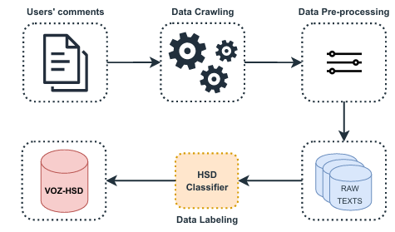
02. Related works
Enhancing Hate Speech Detection in Vietnamese With a Unified Text-to-Text Transformer Model (Deep-Learning)
https://www.researchgate.net/publication/380820655_ViHateT5_Enhancing_Hate_Speech_Detection_in_Vietnamese_With_A_Unified_Text-to-Text_Transformer_Model
This article does not focus on constructing a prediction model but rather on methodologies for the creation of pre-training data, the pre-training techniques utilized, and the fine-tuning procedures undertaken to assemble the unified VIHATET5 model.
1.Automated Pre-training Data Creation:

Slide 8
02. Related works
2.Model Pre-training:
The constructed dataset is employed as the pre-training dataset, comprising samples extracted from real-life comments.
3.Model Fine-tuning:
To evaluate the trained model, we proceed to fine tune the pre-trained VIHATET5 on various hate speech-based datasets such as Hate Speech Detection (ViHSD), Toxic Speech Detection (ViCTSD) and Hate Spans Detection (ViHOS).

Slide 9
02. Related works
4 Model setup:
We would follow the original pre-training strategy outlined for the T5 model (Raffel et al., 2023) to pre train our VIHATET5. Both training and validation are conducted with a batch size of 128. The pre training process is executed over 20 epochs, employing the Adam optimizer with a lower learning rate set at 5e-3. Additionally, a weight decay of 0.001 is applied, with the initial 2,000 steps designated for warm-up during training. In the fine-tuning phase, we would maintain uniform settings for all BERT-based baseline models across specific tasks. Similarly, the same model settings are applied to T5-based models.

Slide 10

02. Related works
A Large-scale Dataset for Hate Speech Detection on Vietnamese Social Media Texts
https://arxiv.org/pdf/2103.11528v4

Slide 11
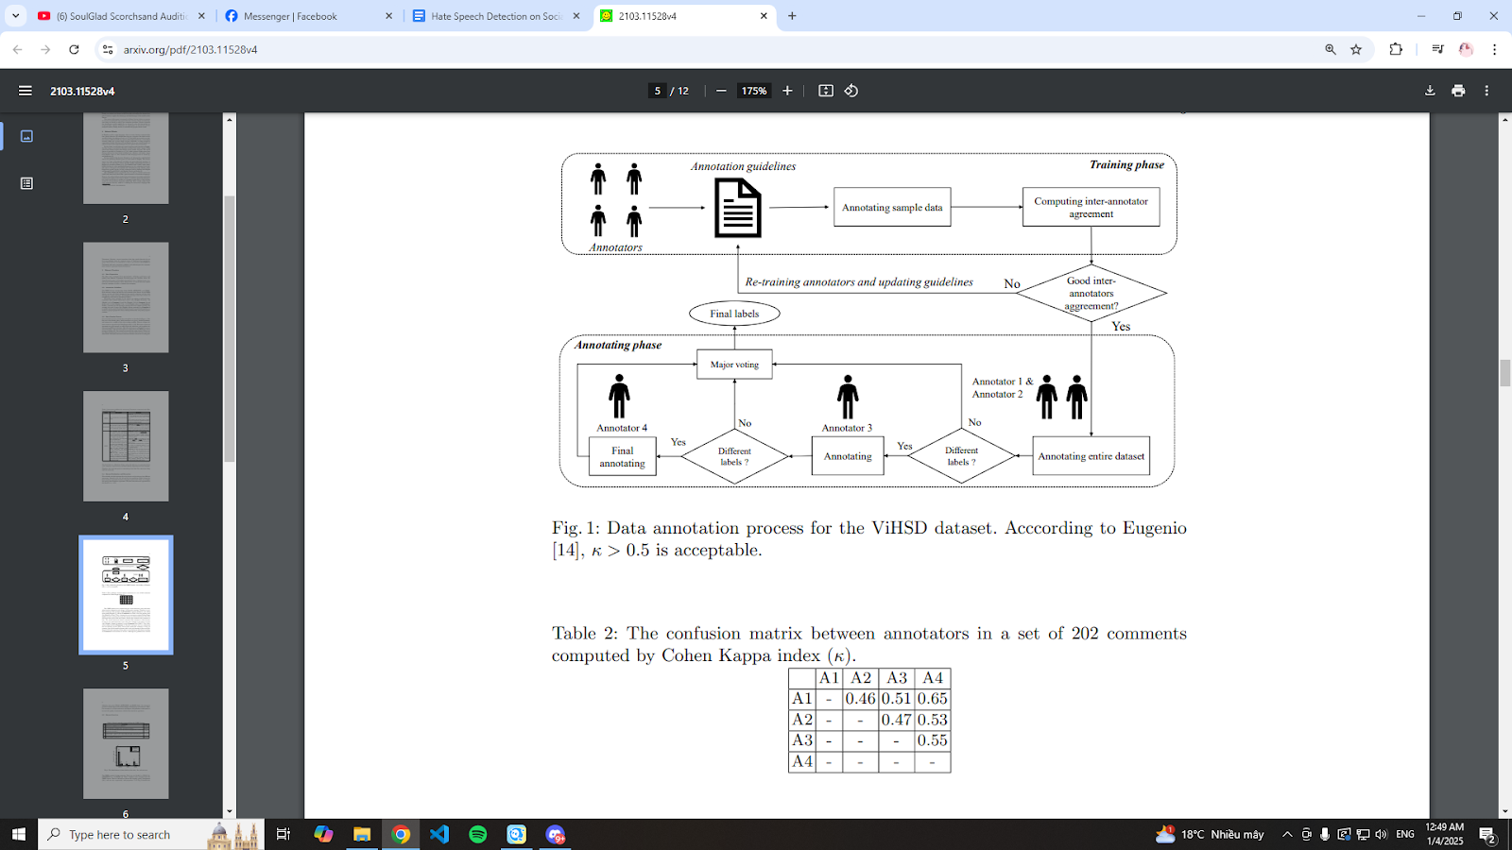
02. Related works

Slide 12
02. Related works
The basic architecture in this paper is Convolutional Neural Network (CNN) with 1D convolutions.In addition, we also study about two other deep neural models which are Long Short Term Memory (LSTM) and Gated Recurrent Unit (GRU). The details of all these neural models are presented in next sub-sections.
In this model, there are several common parts:
Word embedding layer: The input is a matrix of 220x300 dimensions. Each sentence has only 220 words, each word is represented by a 300 dimensional word embedding. Pre-training word level vector is a kind of word representations for deep neural network models since Word2Vec . In our experiments, we choose FastText as our pre-training model.
CNN-1D layer: We use a 1D spatial drop out with 0.2 dropout rate. It can prevent the model from over-fitting and to get better generalizations.
Bidirectional LSTM: Uses two parallel blocks of Bidirectional Long Short Term Memory (Bi-LSTM).LSTM is a variation of a recurrent neural network that has an input gate, an output gate, a forget gate and a cell.. We used sigmoid and tanh for recurrent activations and hidden units respectively.

Slide 13
Implementation using Bi-LSTM-CNN
03

Slide 14
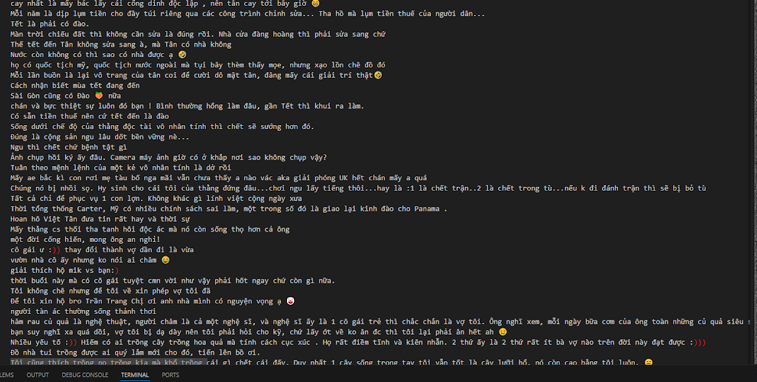
3. Implementation using Bi-LSTM-CNN
Our data was crawled from a vast majority of Vietnamese forums, focusing mainly on Facebook and VOZ communities. The result is over 800 comments, some of which contain emojis or special characters.
Total Clean Comments: 607
Total Offensive Comments: 150
Total Hate Comments: 107

Slide 15
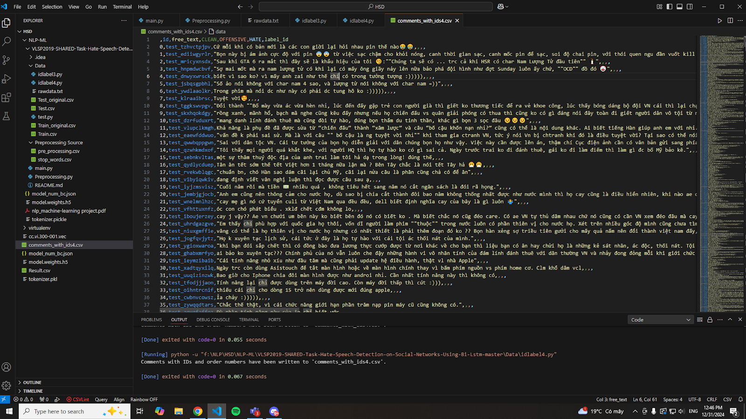
3. Implementation using Bi-LSTM-CNN
Afterwards, we used idlabel4.py to give each comment an ID as well as transform them into the correct format to preprocess. This is the result:

Slide 16
3. Implementation using Bi-LSTM-CNN
We also did the same procedure for another 100 comments but they were used for evaluating the model and the dataset instead.
We use several simple techniques in text pre-processing in all models for this task as follows:
Converting all words to lower case.
Removing extra white spaces, punctuation marks.
Replacing all numbers with "number".
Word tokenization using the pivy library
After that, we would vectorize all the sentences by assigning every word with a unique integer and prepare our word embeddings which basically is start retrieving the vector values of the pre-trained word-embeddings and assign it to all the words that was found in the dataset.

Slide 17
3. Implementation using Bi-LSTM-CNN
Now we setup the model:
Embedding: Initializing the embedding layer with the weights we retrieved from the pre-trained embedding_matrix (cc.vi.300.vec)
SpatialDropout1D: Randomly drops 35% of embed_size (300) to avoid overfitting.
Bi-LSTM: applies a bidirectional wrapper around an LSTM layer to capture dependencies in both forward and backward directions.
Conv1D: applies filters(Kernel) to detect patterns in the sequence of embeddings, it aims to generalize the model further so that it can accurately predicts dataset with similar patterns.

Slide 18
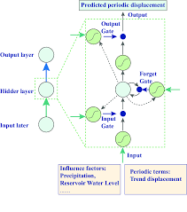
3. Implementation using Bi-LSTM-CNN

Slide 19
3. Implementation using Bi-LSTM-CNN
GlobalAveragePooling1D: acts as a layer in neural networks used for reducing the dimensionality of data while retaining the most important features. It operates on 1D sequence data (like time series or text data represented as sequences).
GlobalMaxPooling1D: also a layer as a layer in neural networks much like global average but instead of selecting the average values of each sentences, it only retrieve the maximum values.
Concatenate: Combine the results of both GlobalAveragePooling and GlobalMaxPooling.
After that, we convert the output by converting the dense vectors into values from 0-1 through an activation function(sigmoid). Finally we configure the model to compile it.

Slide 20
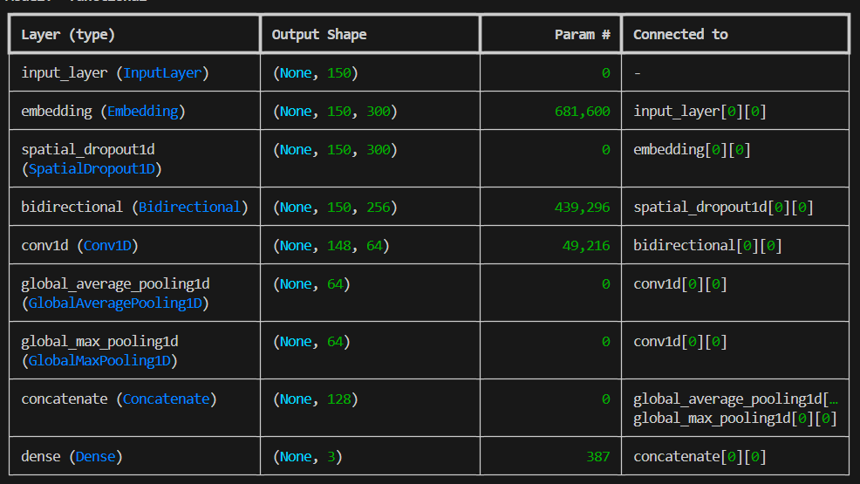
3. Implementation using Bi-LSTM-CNN
Here’s our model summary:

Slide 21
Experiments
04

Slide 22
4.Experiments
Now it’s time to evaluate our model based on the train and test dataset that we’ve made.
Below is the evaluation based on PRC-AUC (Precision-Recall Curve - Area Under Curve)
Since the dataset comprised of mostly CLEAN comments, it would be best if we use PRC-AUC since this evaluation metric is best suited for imbalance datasets and ROC-AUC is mainly used for binary classifiers (such as detecting spam emails). We also added an F1-score valuation purely for an overview of the overall effectiveness of the model.

Slide 23
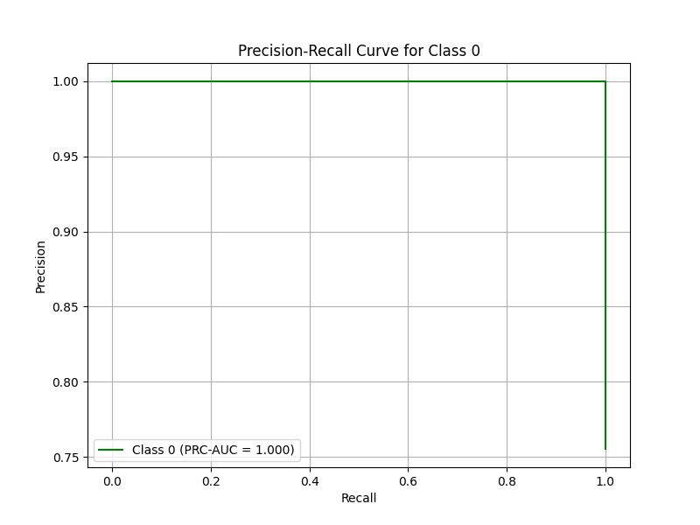
4.Experiments

Slide 24
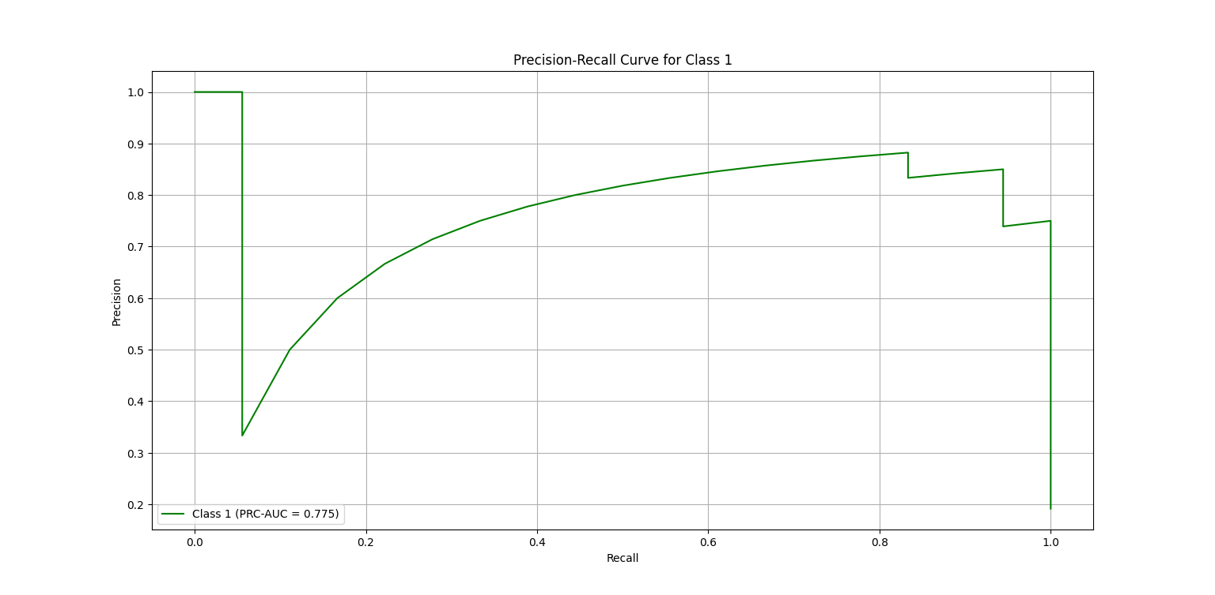
4.Experiments

Slide 25
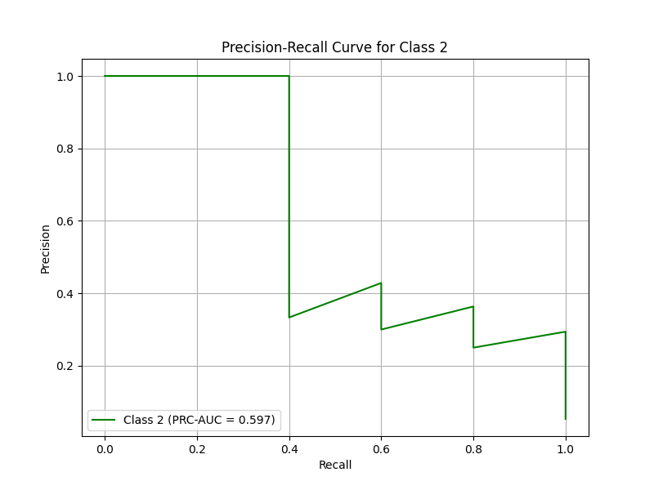
4.Experiments

Slide 26
Conclusion
05

Slide 27
5.Conclusion
Class 0 - PRC-AUC: 1.000, F1-Score: 0.940, TP: 63, FP: 0, TN: 23, FN: 8
Class 1 - PRC-AUC: 0.775, F1-Score: 0.571, TP: 8, FP: 2, TN: 74, FN: 10
Class 2 - PRC-AUC: 0.597, F1-Score: 0.444, TP: 2, FP: 2, TN: 87, FN: 3
Overall Observations:
Class Imbalance:
Class 0 is clearly the dominant class, as it has significantly more true positives and fewer errors.
Classes 1 and 2 might suffer from class imbalance, which could explain their lower performance metrics.
Precision-Recall Tradeoff:
Class 0 achieves an excellent tradeoff with high PRC-AUC and F1-Score.
Classes 1 and 2 show limited tradeoff, due to insufficient samples.

Slide 28
5.Conclusion
In conclusion, our project has provided meaningful insights into hate speech detection using deep learning techniques. Despite the challenges of working with a relatively small dataset, we have been able to design, train, and evaluate a model that shows promise in identifying different types of comments. However, we recognize that the limitations of the dataset—consisting of only around 864 comments—have significantly impacted the model's ability to generalize effectively, particularly for underrepresented classes.
Moving forward, the first and most critical step will be to expand the dataset. A larger and more diverse dataset will not only help balance the classes but also provide the model with richer context for better decision-making. This effort will be complemented by exploring advanced techniques such as attention mechanisms, transformers, and transfer learning to enhance the model's performance and robustness.

Slide 29
THANK YOU !

